Slide 1
The Global Classroom
AN INTERNATIONAL ASSESSMENT PROJECT

Slide 2
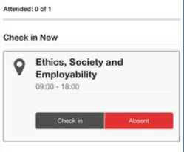
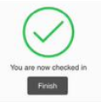
(Only for LTU students)
Step 1: Click the ‘Student Check-In’ tile in the myLTU app and you will see your relevant class. Click ‘Check in’.
Step 2: Your check-in will be registered, and a green tick will appear.
Step 3: Your check-in will then be visible on your ‘History’ tab where you can see your attendance check-in history. You can also access the ‘Help’ tab should you need to.
myLTU Digital Register: Check-in now

Slide 4
Camera off
Microphone off (unless you are asking a question)
If you have questions:
raise your hand or
write your question in the chat box
and your question will be taken at the first opportunity. Feel free to turn your camera on when asking a question if you want to.

Slide 5
What is the Global Classroom?
An international effort developed by three partner universities: Leeds Trinity University (UK), Taylor’s University (Malaysia) and Opole University (Poland).

Slide 6
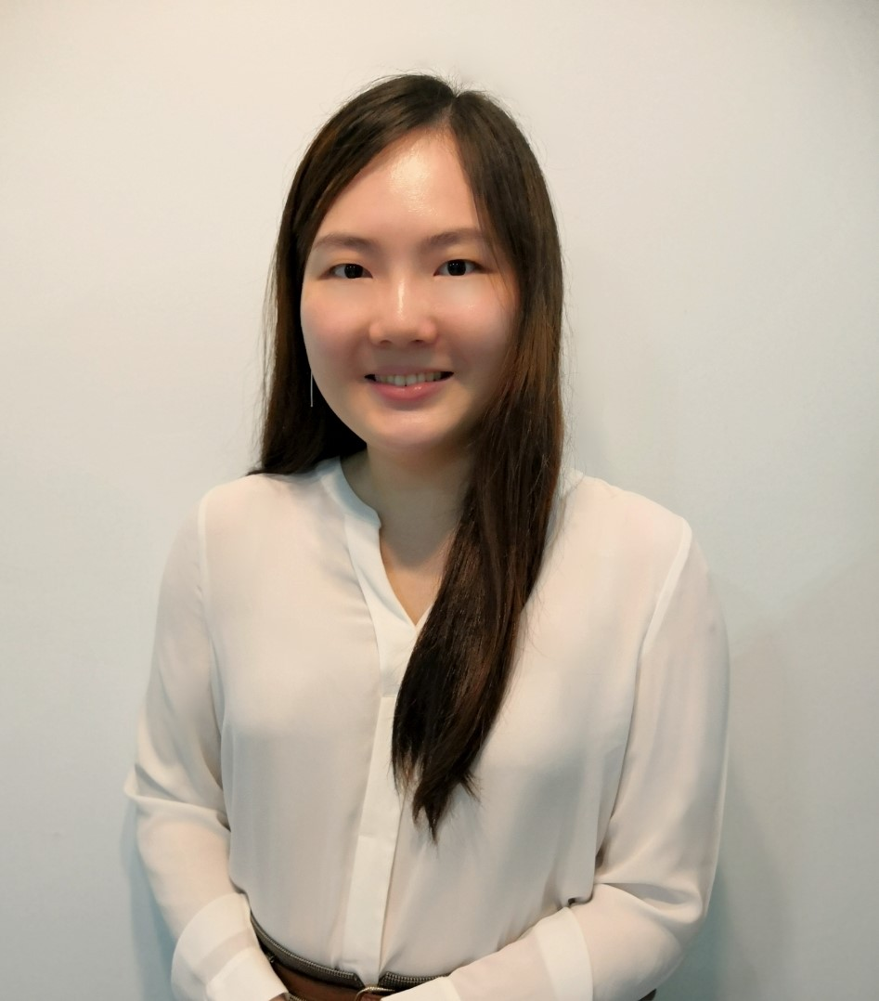
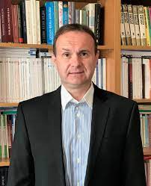
Meet the team!
Dr Laura De Pretto
Leeds Trinity University
Dr Lim Hooi Shan
Taylor’s University
Dr Dariusz Krok
Opole University

Slide 7
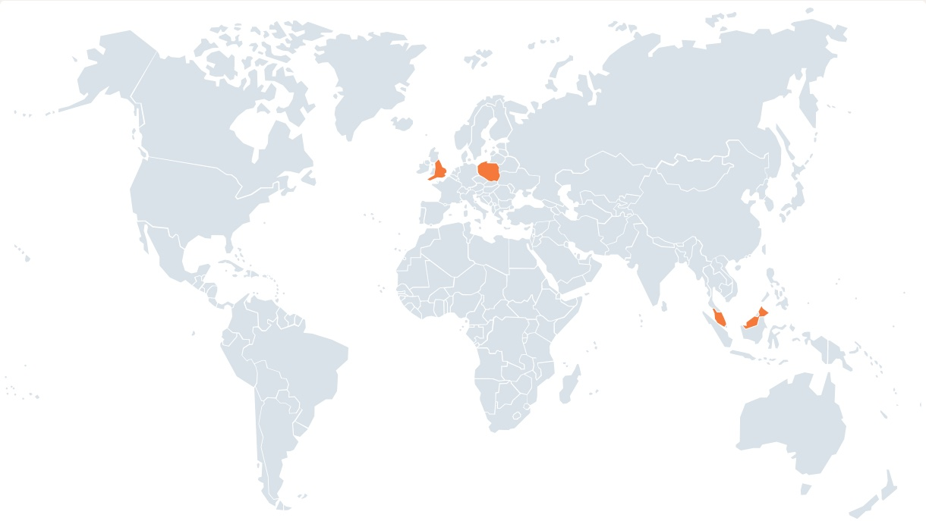
You!

Slide 8
What we will do
Student work (assessed) in international teams
Three-campus sessions
Research on CQ (Cultural Intelligence)
Global
Classroom

Slide 9
Schedule of the project (1)
 | In class | Outside class
Week of Tuesday 12th October | Intro to the project International assessment unpacking Launch of research project | Formation of groups
Week of Tuesday 19th October |  | Student groups meetings Notify lecturers of time Take proof Communicate to lecturer topic and type of work (poster vs presentation)
Week of Tuesday 26th October | Three campus session: Psychological disorders around the world (Dr Lim Hooi Shan) | Student groups meetings Notify lecturers of time Take proof Get in touch with lecturers for feedback

Slide 10
Schedule of the project (2)
 | In class | Outside class
Week of Tuesday 2nd November |  | Student groups meetings Notify lecturers of time Take proof Get in touch with lecturers for feedback
Week of Tuesday 9th November | Three campus session: Coping across cultures (Dr Dariusz Krok) | (optional additional meetings)
Week of Tuesday 16th November | Three campus session: Culture and groups (Dr Laura De Pretto) | (optional additional meetings)

Slide 11
Schedule of the project (3)
 | In class | Outside class
Week of Tuesday 23rd November | Group presentations | Submission of posters (deadline: 12pm UK / 1pm PL / 5pm MY)
Week of Tuesday 30th November | Post-project survey Closing ceremony

Slide 12
Questions?

Slide 13
The Assessment
Student groups
You will be asked to form groups of 7 members. Each group must contain at least 1 student per University.

Slide 14
The Assessment
Poster or Presentation?
Each group can choose
Poster
1,000 words
1 page
Attractive format
Needs to be submitted
Presentation
10 minutes + Q&A
Attractive format
Needs to be presented (but not submitted)

Slide 15
The Assessment
Assessment Brief
Examples of topics
Psychological disorders
Coping
Social behavior
Parenting and child rearing practices
Relationships with significant others
Significance of education and/or work
Concept of success
Symbolic use of music
Respect for authority
Gender roles
Psychological societies and regulations of the discipline
Compare and contrast a topic of choice (within psychology) in the three represented countries (UK, Malaysia and Poland), with the support of psychological literature.

Slide 16
The Assessment
What you need to do
Meet with your group mates at least three times (more if you wish so).
You can use MS Teams to hold their meetings (or any other platform.
In addition to submitting your final assignment (poster or presentation), you will be required to submit a log of your meetings. This component will be compulsory but unmarked (pass/fail).

Slide 17
The Assessment
How you will be marked
Equivalent grades
Team marking
Marking rubrics

Slide 18
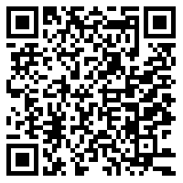
Groups sign-up https://docs.google.com/spreadsheets/d/1AgtfKOV-_3q8IQIjSa6XSDmYuJAXP-SwAGaGBY_VR1E/edit?usp=sharing

Slide 19
Questions?

Slide 20
How we will evaluate the project
Cultural Intelligence (CQ) refers to a person’s capability to understand and act appropriately across a wide range of cultures (Plum, 2009).
Will students’ CQ increase thanks to the project?
E-CQS (Expanded Cultural Intelligence Scale) (VanDyne et al., 2012):
- Motivational CQ
- Cognitive CQ
- Metacognitive CQ
- Behavioural CQ

Slide 21
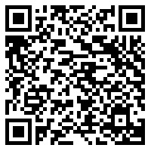
The survey
Participation is anonymous
Participation is voluntary
Participating (or not) will not affect your grade nor your relationship with your university
Please read the Info Sheet
You can then ask questions
Decide if you want to take part
If so: https://ltu.onlinesurveys.ac.uk/global-classroom-and-cultural-intelligence_version-2

Slide 22
Questions? Comments?

Slide 23
See you…
Next week in each respective university group.
On Tuesday 26th October all together for Dr Lim Hooi Shan’s session on Psychological Disorders Around The World.

